Slide 1

Digital Technology Merit Badge
Troop344/9344
Pemberville, OH

Slide 2


Digital Technology Requirements
View the Personal Safety Awareness "Digital Safety" video (with your parent or guardian's permission).
Do the following:
  Give a brief history of the changes in digital technology over time. Discuss with your counselor how digital technology in your lifetime compares with that of your parent's, grandparent's, or other adult's lifetime.
  Describe what kinds of computers or devices you imagine might be available when you are an adult.
Do the following:
  Explain to your counselor how text, sound, pictures, and videos are digitized for storage.
  Describe the difference between lossy and lossless data compression, and give an example where each might be used.
  Describe two digital devices and how they are made more useful by their programming.
  Discuss the similarities and differences between computers, mobile devices, and gaming consoles.
  Explain what a computer network is and describe the network's purpose.

Slide 3

Digital Technology Requirements
Do the following:
  Explain what a program or software application or "app" is and how it is created.
  Name four software programs or mobile apps you or your family use, and explain how each one helps you.
  Describe what malware is, and explain how to protect your digital devices and the information stored on them.
Do the following:
  Describe how digital devices are connected to the internet.
  Using an internet search engine (with your parent or guardian's permission), find ideas from at least three different websites about how to conduct a troop court of honor or campfire program. Present the ideas to your counselor, and explain how you used a search engine to find this information.
  Use a web browser to connect to an HTTPS (secure) website (with your parent's permission). Explain to your counselor how to tell whether the site's security certificate can be trusted, and what it means to use this kind of connection.

Slide 4
Digital Technology Requirements
Do THREE of the following. For each project you complete, copy the files to a backup device and share the finished projects with your counselor.
  Using a spreadsheet or database program, develop a food budget for a patrol weekend campout OR create a troop roster that includes the name, rank, patrol, and telephone number of each Scout. Show your counselor that you can sort the roster by each of the following categories: rank, patrol, and alphabetically by name.
  Using a word processor, write a draft letter to the parents of your troop's Scouts, inviting them to a troop event.
  Using a graphics program, design and draw a campsite plan for your troop OR create a flier for an upcoming troop event, incorporating text and some type of visual such as a photograph or an illustration.
  Using a presentation software program, develop a report about a topic approved by your counselor. For your presentation, create at least five slides, with each one incorporating text and some type of visual such as a photograph or an illustration.
  Using a digital device, take a picture of a troop activity. Send or transfer this image to a device where it can be shared with your counselor.
  Make a digital recording of your voice, transfer the file to a different device, and have your counselor play back the recording.
  Create a blog and use it as an online journal of your Scouting activities, including group discussions and meetings, campouts, and other events. Include at least five entries and two photographs or illustrations. Share your blog with your counselor. You need not post the blog to the Iinternet; however, if you choose to go live with your blog, you must first share it with your parents AND counselor AND get their approval.
  Create a web page for your troop, patrol, school, or place of worship. Include at least three articles and two photographs or illustrations. Include at least one link to a website of interest to your audience. You need not post the page to the internet; however, if you decide to do so, you must first share the web page with your parents AND counselor AND get their approval.

Slide 5
Digital Technology Requirements
Do the following:
  Explain to your counselor each of these protections and why they exist: copyright, patents, trademarks, trade secrets.
  Explain when it is permissible to accept a free copy of a program from a friend.
  Discuss with your counselor an article or a news report about a recent legal case involving an intellectual property dispute.
Do TWO of the following:
  Describe why it is important to properly dispose of digital technology. List at least three dangerous chemicals that could be used to create digital devices or used inside a digital device.
  Explain to your counselor why it is important to use a certified recycler of digital technology hardware or devices.
  Do an internet search for an organization that collects discarded digital technology hardware or devices for repurposing or recycling. Find out what happens to that waste. Share with your counselor what you found.
  Visit a recycling center that disposes of digital technology hardware or devices. Find out what happens to that waste. Share what you learned with your counselor.
  Find a battery recycling center near you and find out what it does to recycle batteries. Share what you have learned with your counselor about the proper methods for recycling batteries.
Do ONE of the following:
  Identify three career opportunities that involve digital technology. Pick one and investigate the education, training, and experience required for this profession. Discuss this with your counselor, and explain why this profession might interest you.
  Visit a business or an industrial facility that uses digital technology. Describe four ways digital technology is being used there. Share what you learned with your counselor.

Slide 6
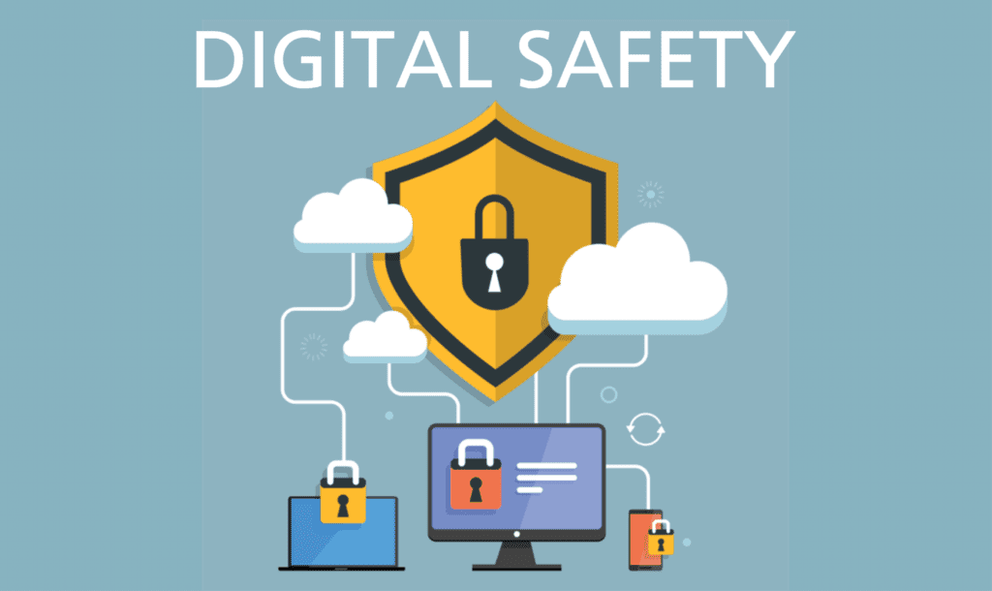
Requirement 1
View the Personal Safety Awareness "Digital Safety" video (with your parent or guardian's permission). It may only play properly in the latest version of Chrome or Edge browsers.

Slide 7
Requirement 2
Do the following:
  Give a brief history of the changes in digital technology over time. Discuss with your counselor how digital technology in your lifetime compares with that of your parent's, grandparent's, or other adult's lifetime.
  Describe what kinds of computers or devices you imagine might be available when you are an adult.

Slide 8
What is Digital Technology
Digital technologies are electronic tools, systems, devices and resources that generate, store or process data.
  Well known examples include social media, online games, multimedia and mobile phones.
When information is stored, transmitted or forwarded in digital format, it is converted into binary code.
Binary code is based on a binary number system in which there are only two possible states, off and on, usually symbolized by 0 and 1.
Computers interpret and translate complex binary strings into meaningful code, letters and numbers.
  ASCII is the term referring to recognizable characters such as numbers, letters and symbols.
  These characters are equal to Binary groups of eight 1s and 0s per character
  A in Binary is 010000001
  5 in Binary is 00110101
  # in Binary is 00100011

Slide 9

History of Digital Technology
In the past three decades, the United States has seen staggering technological changes.
In 1984, just 8 percent of households had a personal computer, the World Wide Web was still five years away, and cell phones were enormous.
The following slides show how some key parts of our technological lives have shifted for those born in 1984.
Vintage vs. Modern

Slide 10
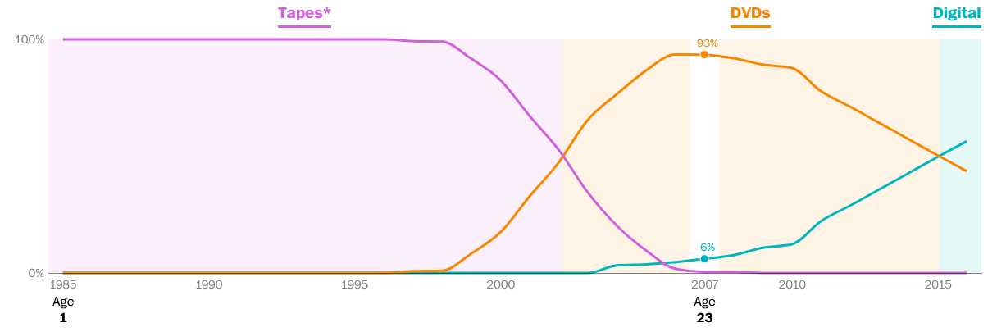
How did people watch videos?
Share of U.S. home entertainment spending by format:
When you were 18 in 2002, 53% of U.S. home entertainment spending was Tapes, and the top movie in theaters was Spider-Man.
When you were 1 in 1985, most of U.S. home entertainment spending was Tapes, and the top movie in theaters was Back to the Future.

Slide 11
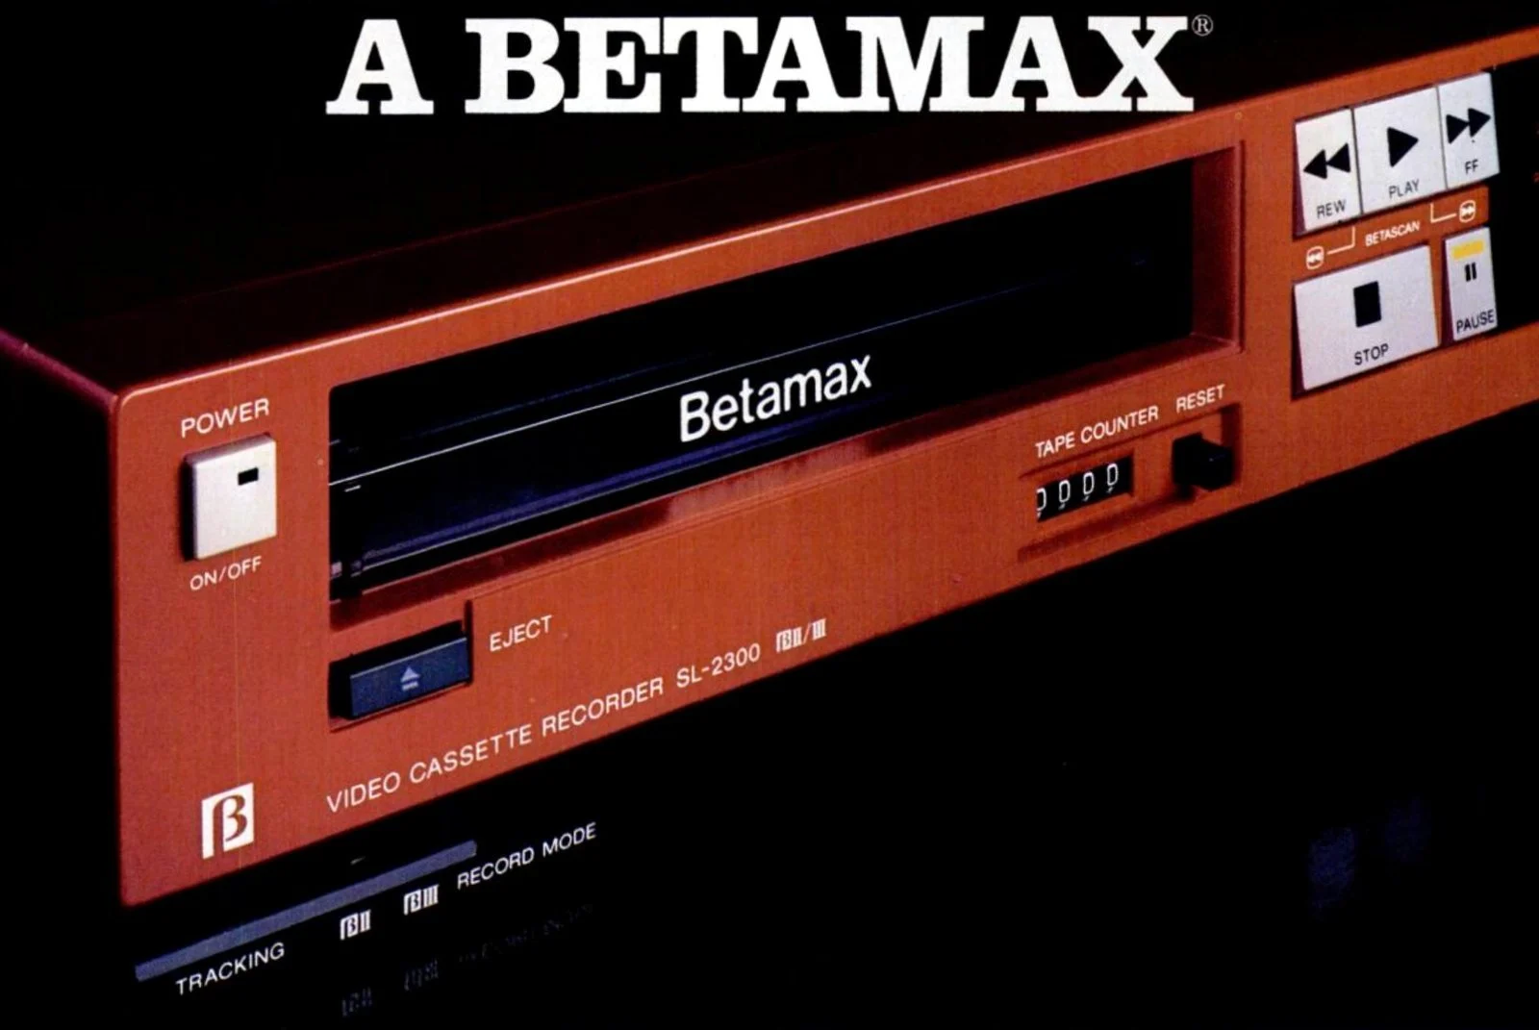
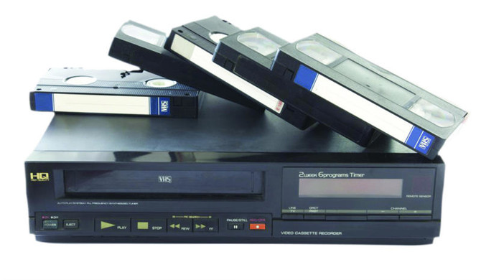
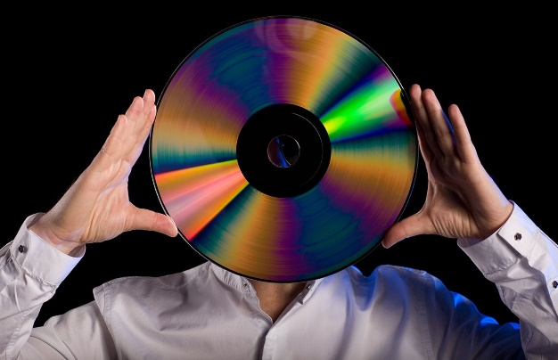
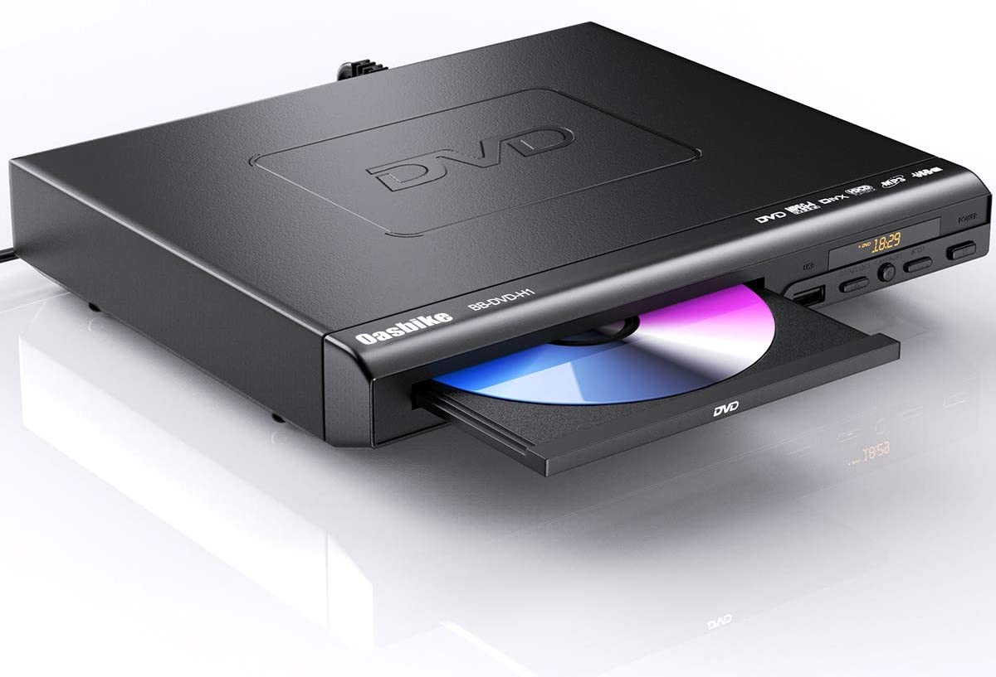

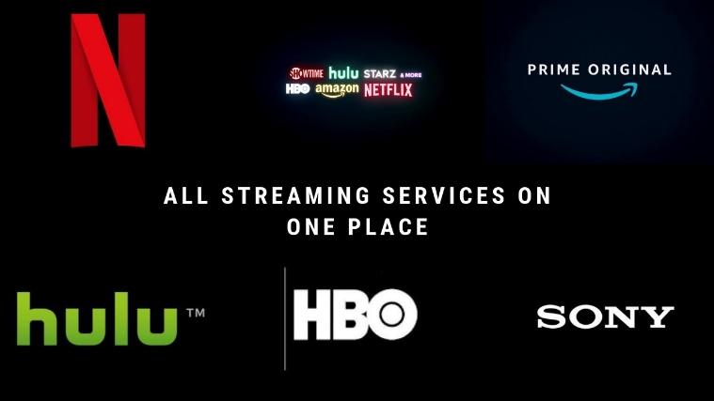
History of Home Videos
Betamax - 1975
VHS - 1976
LaserDisc - 1978
DVD - 1996
Blue Ray - 2006
Video Streaming - 2007

Slide 12
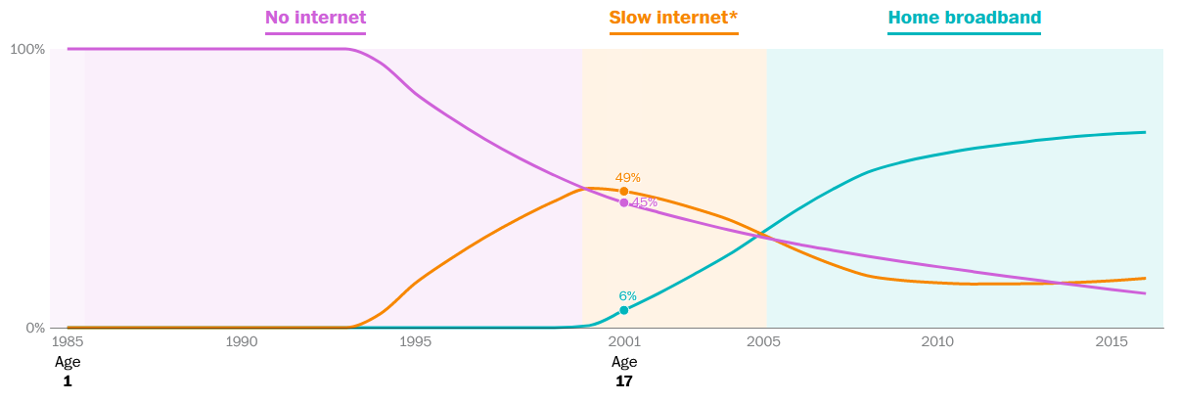
Did people have internet access?
Estimated share of Americans that used each type of internet:
When you were 14 in 1998, 61% of U.S. households had No internet, and the top website was AOL.
When you were 1 in 1985, 100% of U.S. households had No internet.

Slide 13
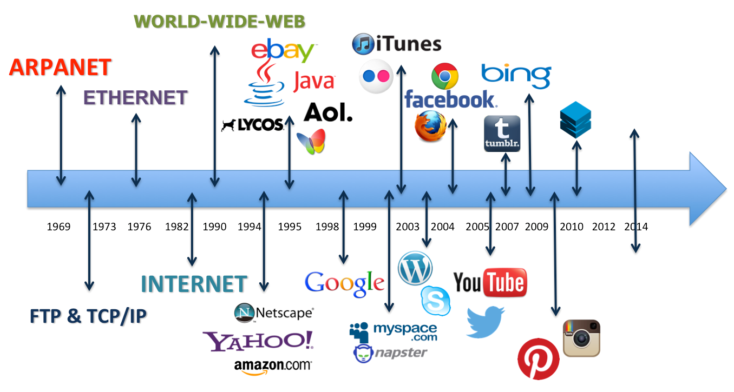
Internet Timeline

Slide 14
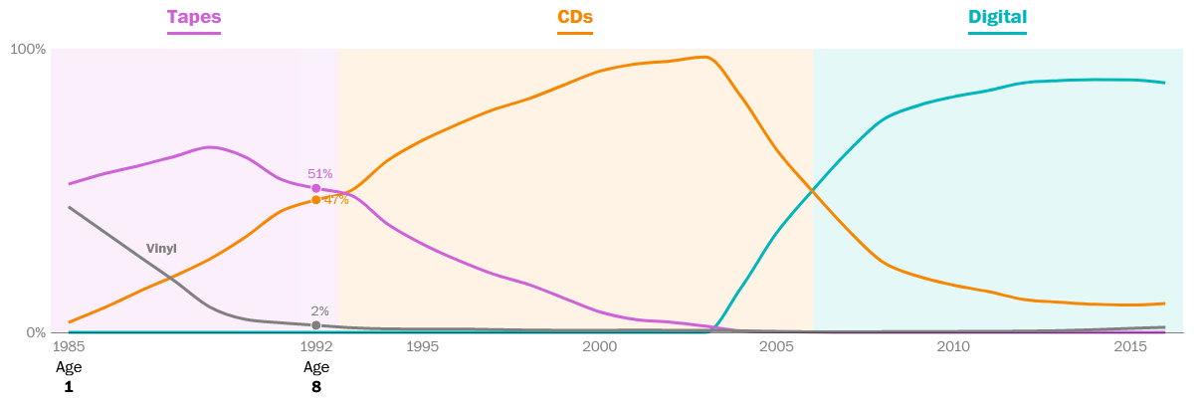
How did people listen to music?
Share of U.S. music sales (volume) by format:
When you were 6 in 1990, 62% of U.S. music sales (by volume) were Tapes, and the top selling album was Janet Jackson – Janet Jackson's Rhythm Nation 1814.
When you were 1 in 1985, 52% of U.S. music sales (by volume) were Tapes, and the top selling album was Bruce Springsteen – Born in the U.S.A.

Slide 15
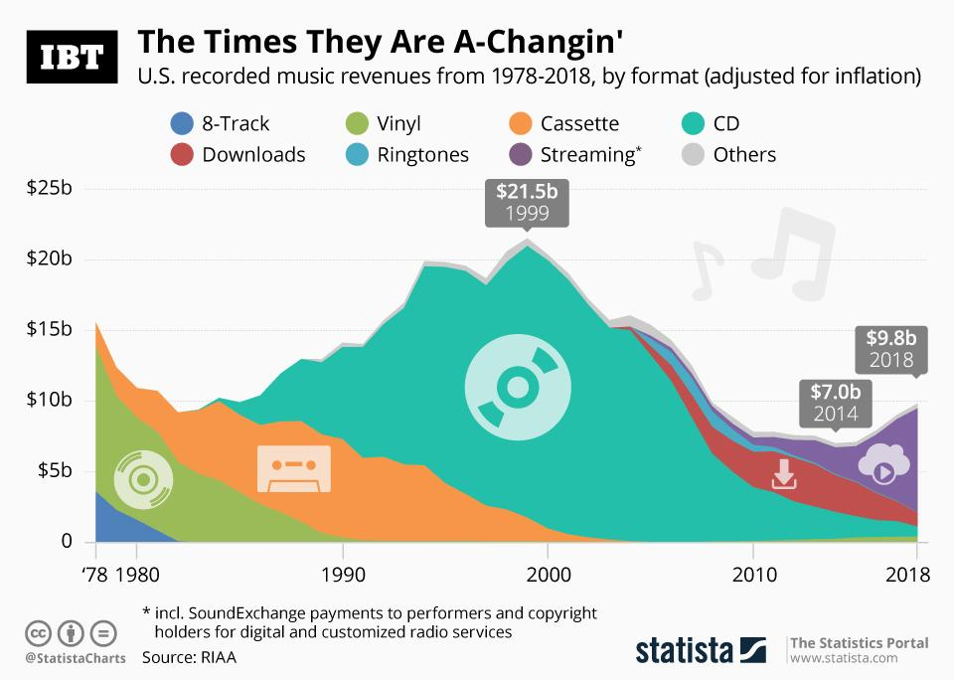

Slide 16
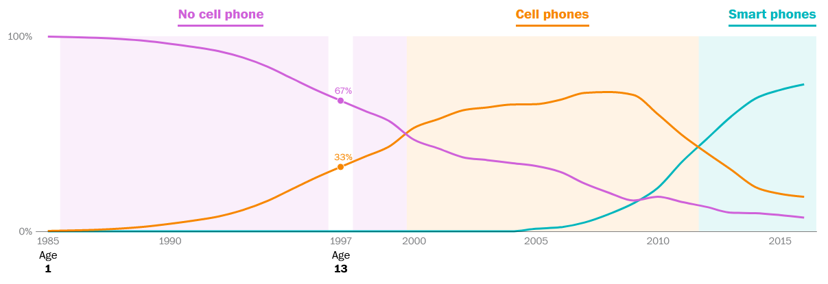
Did people have cell phones?
Estimated share of Americans that owned each device:
When you were 9 in 1993, 89% of Americans had No cell phone.
When you were 1 in 1985, over 99% of Americans had No cell phone.

Slide 17
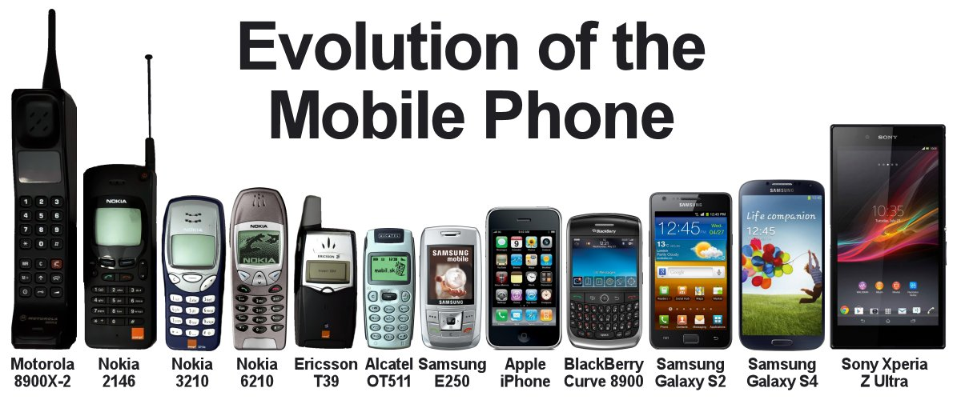

Slide 18
Requirement 2
Do the following:
  Give a brief history of the changes in digital technology over time. Discuss with your counselor how digital technology in your lifetime compares with that of your parent's, grandparent's, or other adult's lifetime.
  Describe what kinds of computers or devices you imagine might be available when you are an adult.

Slide 19
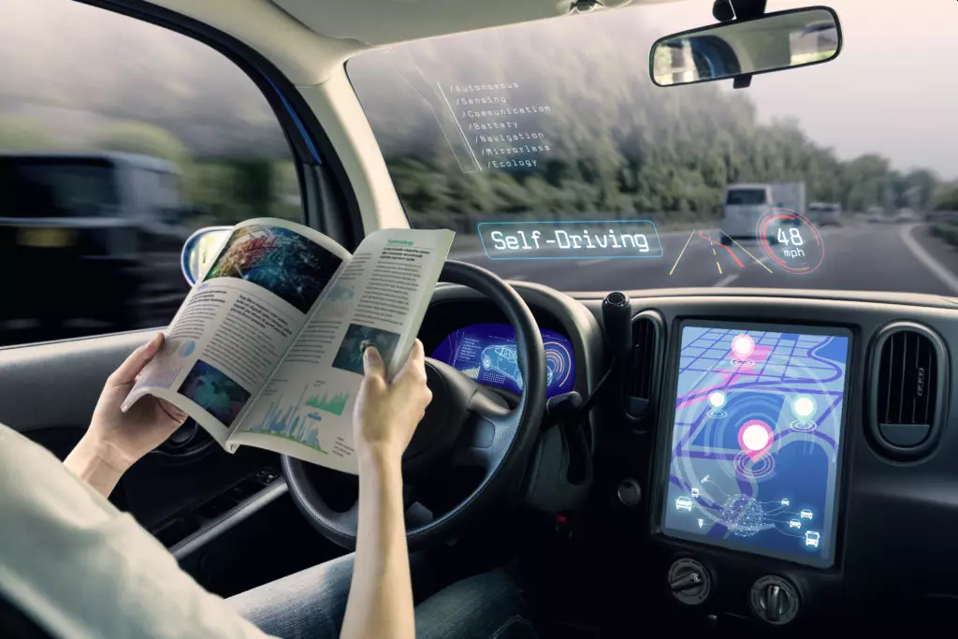
Future of Digital Technology
Artificial Intelligence
  The holy grail of artificial intelligence research is general AI, a machine that is self-aware and commands intelligence equal to a person’s.
  These theoretical systems would be our intellectual equals—well, until v2.0 drops and we fall to a distant second.
  Until then we have narrow AI, which are systems that perform very specific tasks.
  Chatbots, logistics, self-driving cars, virtual nursing assistants, personalized textbooks and tutors, and even artificial creativity are just a few of the applications that narrow AI can improve or bring to light in the coming years.

Slide 20
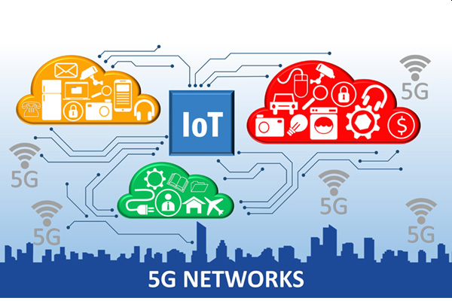
Future of Digital Technology
5G and the Internet of Things (IoT)
  5G networks may ultimately be 100 times faster than 4G, allowing many more devices to connect, reducing latency to practically zero, and providing more reliable signals.
  This wireless technology will provide the backbone for the internet of things (IoT), which will expand the power of the internet beyond computers and across a wide range of objects, processes, and environments.
  The IoT is the keystone technology for such futuristic scenes as smart cities, robot-driven agriculture, and self-driving highway systems.

Slide 21
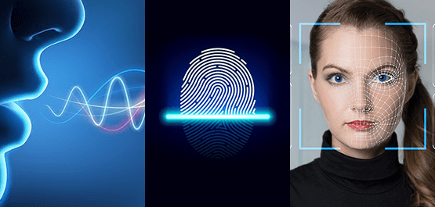
Future of Digital Technology
Biometrics
  Biometrics allows a system to recognize users by biological markers such as their face, voice, or fingerprint.
  Many people already have one or several of these on their laptops and smartphones, but as the technology improves, it may finally end the password paradigm.
  Because most people have inefficient passwords, use the same one for every account, and never change them, hackers typically need only one hit to enjoy unlimited access to someone’s personal and professional data.
  For these reasons, biometrics promises much-needed security of sensitive data.
  A fingerprint is much more difficult to hack with raw computational power than a password, and that difficulty is increased by magnitudes when multiple markers are used together.

Slide 22
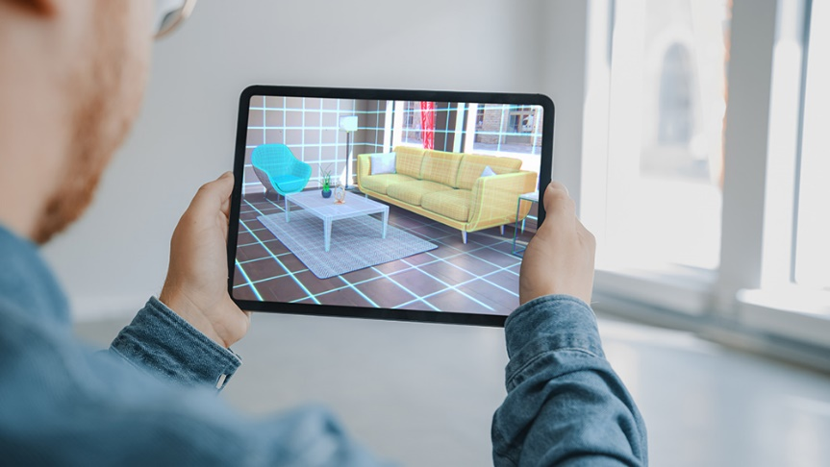
Future of Digital Technology
Augmented/Virtual Reality
  With hardware costs lowering, processing power increasing, and high-profile players such as Google and Facebook entering the game, virtual reality’s day may have finally come.
  The more widespread acceptance of augmented reality apps in smartphones may make such technologies an easier sell moving forward.
  New remote-work era is a concept that combines these “mixed-reality” technologies to create virtual shared spaces that business teams can use to hold meetings or work on projects.
  This technology can revolutionize the customer experience in retail by allowing them to try clothes on a virtual avatar or sit in their amphitheater seats before making a purchase.

Slide 23
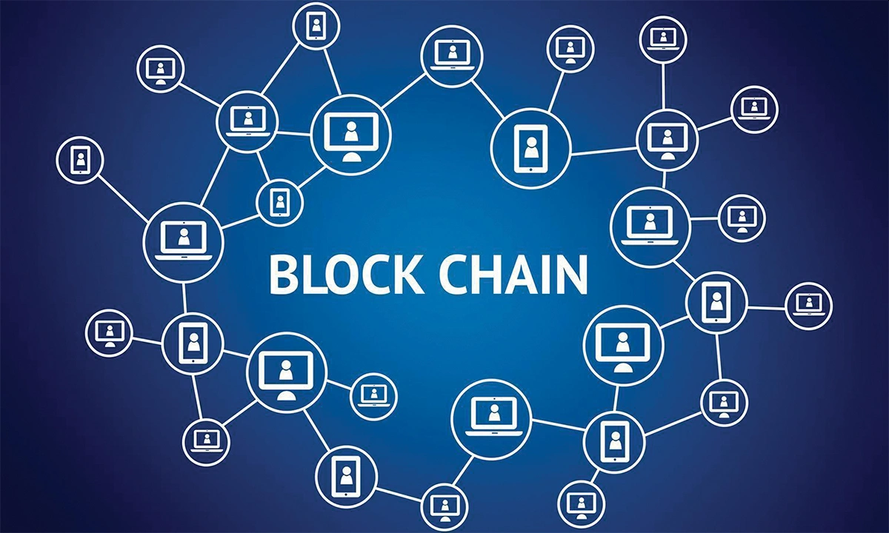
Future of Digital Technology
Blockchain
  Unlike traditional, centralized records, a blockchain is decentralized.
  The permanent record is not stored in one location but exists on nodes spread across the system.
  This design makes it difficult to lose records or tamper with them.
  This is why blockchain has caught the attention of organizations that need to store records (i.e., all organizations).
  The potential use cases are impressive.
  Blockchain could be used by hospitals to store and share health records. It could underpin a secure online voting platform. It could track logistics across international supply chains. And, of course, there are numerous applications for cybersecurity, too.

Slide 24
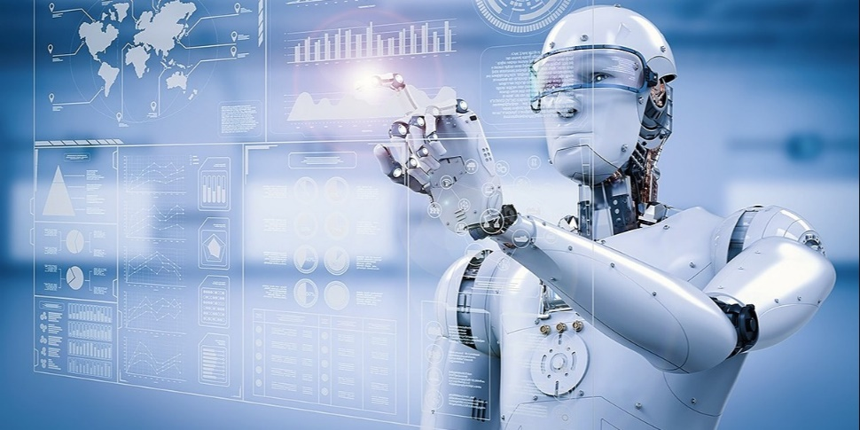
Future of Digital Technology
Robotics
  The first industrial robot punched the clock in 1962.
  Technological advancements have steadily widened robotics’ workforce representation since, and in the coming years, robots will continue moving from factories to First Street to perform rudimentary tasks such as cleaning and delivery.
  One challenge faced by organization leaders will be reassuring their teams that the robots aren’t here to replace them.
  In fact, as more people move into soft-skilled, human-focused jobs, they’ll likely find the transition a beneficial one.

Slide 25
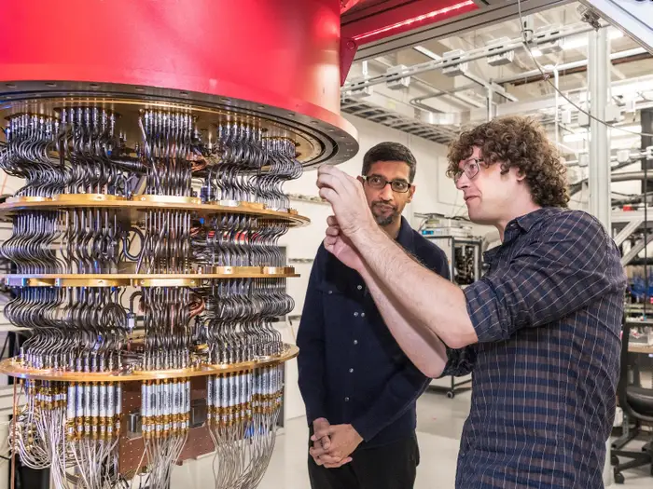
Future of Digital Technology
Quantum Computing
  Quantum computing is “the exploitation of collective properties of quantum states, such as superposition and entanglement, to perform computation.”
  Translation: It solves problems faster and more accurately—in some cases, ones that stump even modern supercomputers.
  Adoption of this technology could make big data more manageable.
  It could cut costly and complex development time through speedy simulations.

Slide 26
Requirement 3
Do the following:
  Explain to your counselor how text, sound, pictures, and videos are digitized for storage.
  Describe the difference between lossy and lossless data compression, and give an example where each might be used.
  Describe two digital devices and how they are made more useful by their programming.
  Discuss the similarities and differences between computers, mobile devices, and gaming consoles.
  Explain what a computer network is and describe the network's purpose.

Slide 27
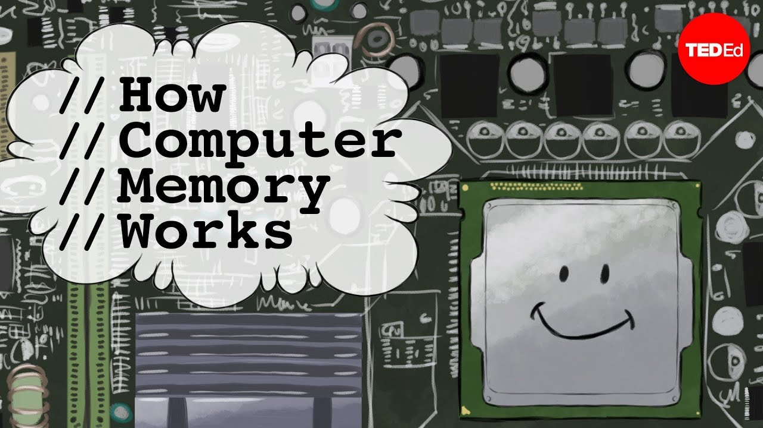
How does data storage work?
When you stop to think about it, it’s really incredible how a device like your cellphone can capture an image of reality, turn it into a bunch of data, and store it forever.
How does the data digitization and storage process work?
The following TED video (5:05) does a fantastic job of explaining how computer memory works, as well as its current drawbacks:

Slide 28
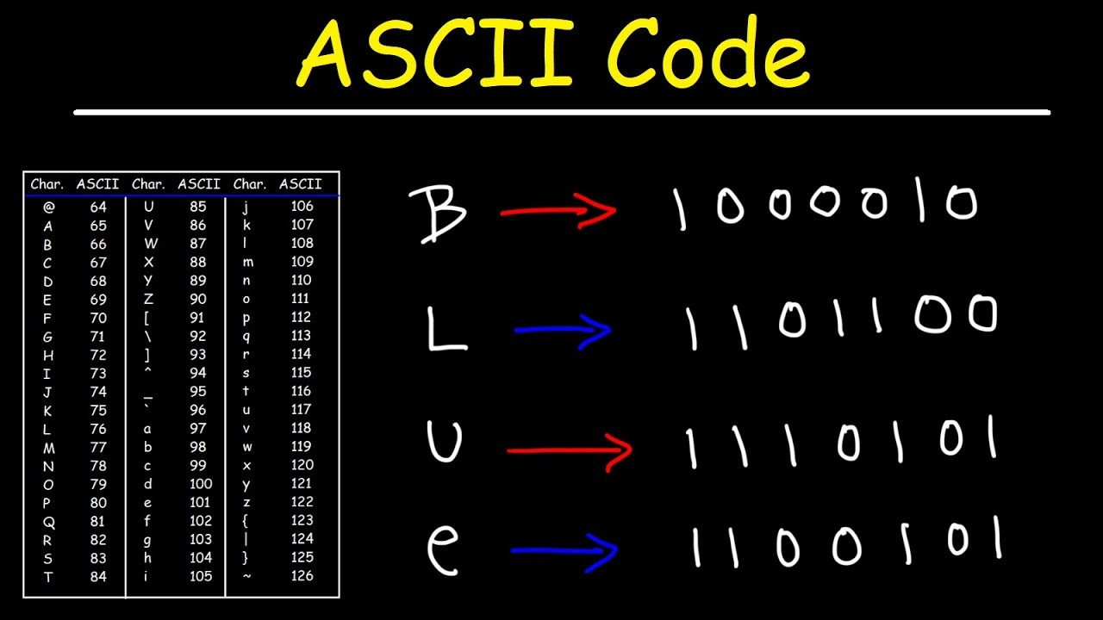
Digitizing Data
How is Text Digitized for Storage?
  Digital text is stored using ASCII (American Standard Code for Information Interchange), which is a code that translates numbers, letters, and special characters to numbers between 0 and 255.
  These numbers are translated to binary by computers, which is another code made up of a sequence of 0s and 1s.
Digital Formats: txt, doc, ods, pdf

Slide 29
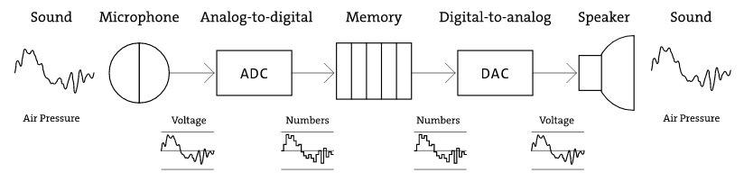
Digitizing Data
How Is Sound Digitized for Storage?
  Sound becomes digitized and stored via a process called sampling.
  During the sampling process, analog sound (regular sound waves) are converted into bits that the computer can read and save as a digital file; basically a long list of 1’s and 0’s.
  When you replay the file, the data is used to rebuild the shape of the sound wave and sends that information to the speakers, which vibrate the air, re-creating the original sound wave that you can hear.
Digital Formats: mp3, wma, aiff, wav

Slide 30
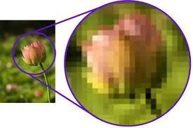
Digitizing Data
How Are Pictures Digitized for Storage?
  Pictures are stored as pixels, which essentially look like a series of small dots.
  You can see these when you zoom in really close to a picture online and it becomes broken up into squares, a process called pixelization.
  Each pixel holds information and data, measured in bits (unit of computer memory).
  Color pictures take more bits, and therefore also take up more memory.
Digital Formats: jpg, gif, png, tiff

Slide 31
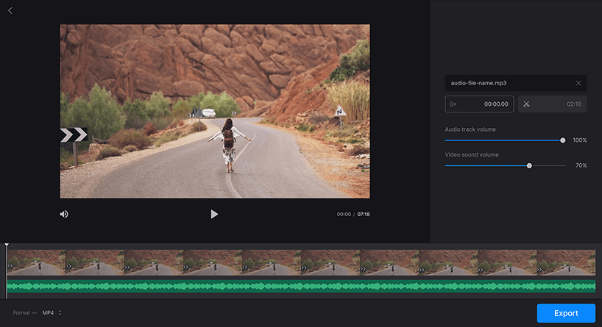
Digitizing Data
How Are Videos Digitized for Storage?
  Videos are digitized through a combination of how sound and pictures are digitized.
  Generally, a video file is collected as separate parts: sequential pictures, and synchronized sound.
  Both of those files are given time stamps so that they can overlap to form a coherent video, and then are stored in container files.
Digital Formats: avi, mpeg, flv, mov

Slide 32
Requirement 3
Do the following:
  Explain to your counselor how text, sound, pictures, and videos are digitized for storage.
  Describe the difference between lossy and lossless data compression, and give an example where each might be used.
  Describe two digital devices and how they are made more useful by their programming.
  Discuss the similarities and differences between computers, mobile devices, and gaming consoles.
  Explain what a computer network is and describe the network's purpose.

Slide 33
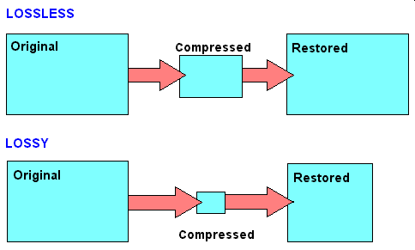
Data Compression
Picture, image, music, and video files are stored in many different formats.
  Some formats use specialized mathematical formulas to compress the file.
  The file takes up less disk space and is easier to email, listen to, or display on the Web, but some of the original data is sacrificed and cannot be restored.
  This is called lossy compression.
  Examples: JPG, GIF, MP3
Another type of compression, called lossless, can temporarily shrink a file by removing parts that are repeated and then, later restore the file to its full size.
  Lossless compression is often used with text files and database files.
  Lossless compression is also used when you want to retain the original picture size.
  Examples: WMA, PNG, WebP

Slide 34
Requirement 3
Do the following:
  Explain to your counselor how text, sound, pictures, and videos are digitized for storage.
  Describe the difference between lossy and lossless data compression, and give an example where each might be used.
  Describe two digital devices and how they are made more useful by their programming.
  Discuss the similarities and differences between computers, mobile devices, and gaming consoles.
  Explain what a computer network is and describe the network's purpose.

Slide 35
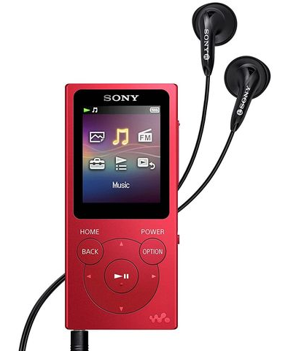
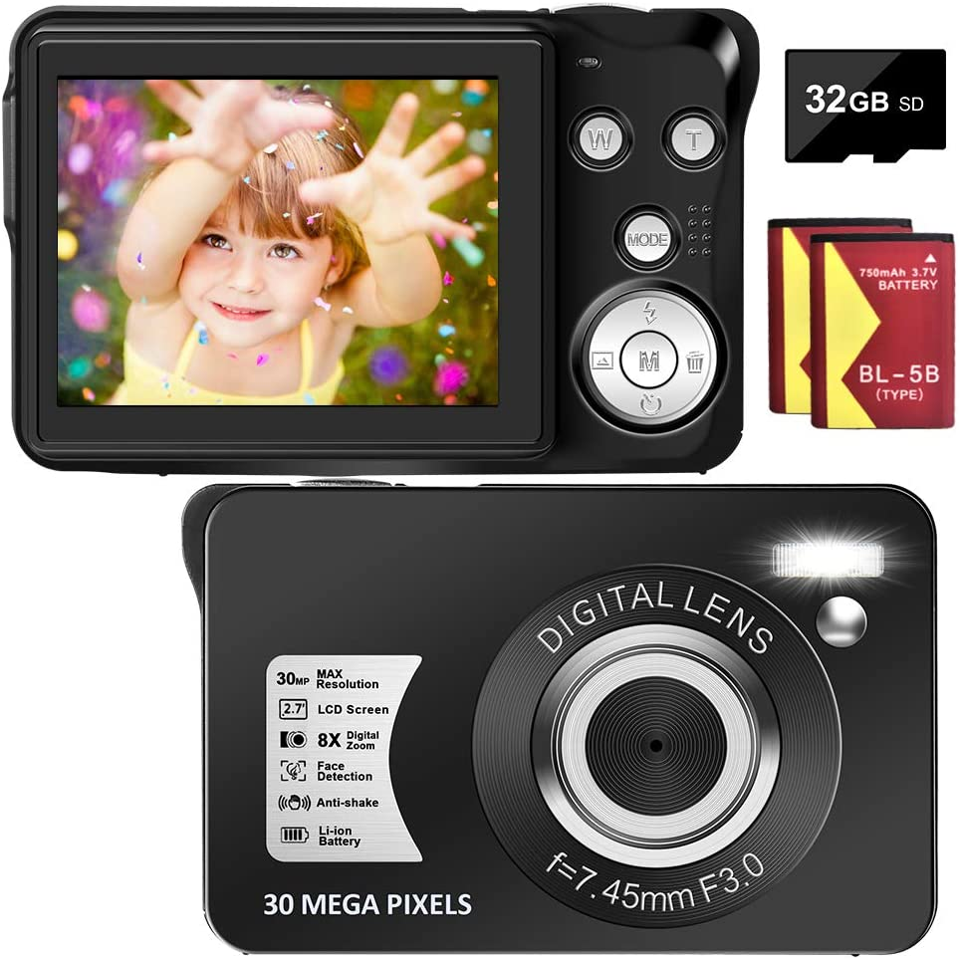
Digital Devices
MP3 Player:
  The MP3 player uses software to interface with the hardware to translate the signals produced by powering the unit on and by navigating the device’s menu by pressing buttons or rotating dials.
  The software programming also facilitates the input of MP3 files into the devices internal memory storage and the conversion of the files into sound that you can hear using headphones or the device’s internal speaker.
Digital Camera:
  Digital cameras also use software programming to provide digital instructions to the device’s hardware components such as opening the lens and triggering the shutter.
  The software programming also provides an interface to adjust the devices settings and features and to control the image as is copied to the device’s memory storage unit, usually a separate memory chip.

Slide 36
Requirement 3
Do the following:
  Explain to your counselor how text, sound, pictures, and videos are digitized for storage.
  Describe the difference between lossy and lossless data compression, and give an example where each might be used.
  Describe two digital devices and how they are made more useful by their programming.
  Discuss the similarities and differences between computers, mobile devices, and gaming consoles.
  Explain what a computer network is and describe the network's purpose.

Slide 37
Digital Technology
Computers, Gaming Consoles & Mobile Devices
3D
 | Computers | Gaming Consoles | Mobile Devices
Similarities | Processors (CPU’S), Executable Programs, Install Software, Digital Storage, Displays, Internet Access, Audio
Differences | Keyboards vs. Touchscreens vs. Controllers, Portability, Number of Users, Proprietary Media or Apps, Expansion, Online platforms

Slide 38
Requirement 3
Do the following:
  Explain to your counselor how text, sound, pictures, and videos are digitized for storage.
  Describe the difference between lossy and lossless data compression, and give an example where each might be used.
  Describe two digital devices and how they are made more useful by their programming.
  Discuss the similarities and differences between computers, mobile devices, and gaming consoles.
  Explain what a computer network is and describe the network's purpose.

Slide 39
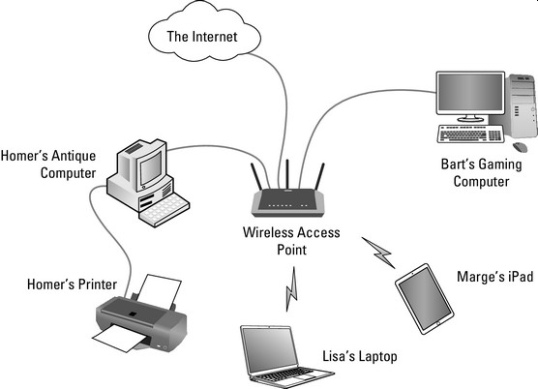
Computer Networks
A computer network is a set of computers that are connected together so that they can share information.
Computer networks are used to carry out a large number of tasks through the sharing of information that include:
  Communicating using email, video, instant messaging and other methods
  Sharing devices such as printers, scanners and photocopiers
  Sharing files
  Sharing software and operating programs on remote systems
  Allowing network users to easily access and maintain information

Slide 40
Requirement 4
Do the following:
  Explain what a program or software application or "app" is and how it is created.
  Name four software programs or mobile apps you or your family use, and explain how each one helps you.
  Describe what malware is, and explain how to protect your digital devices and the information stored on them.

Slide 41

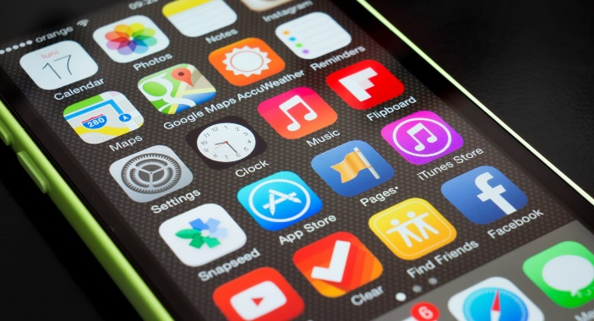
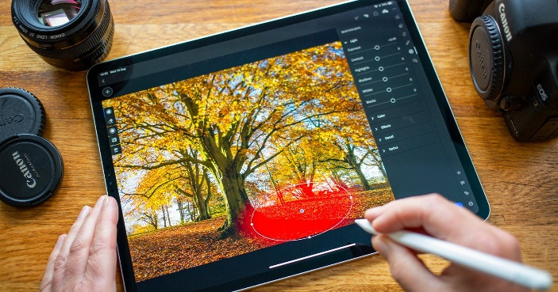
Software
A program or software application is a group or set of instructions that are stored in memory and are acted upon, in sequence, by the device’s central processing unit (CPU) to complete a task.
  Examples include: Word Processing, Games, Utilities (calendar, calculator), Photo/Video Editor
In the course of executing program instructions, the CPU will communicate or share data with random access memory (RAM), graphical display, sound device, and any other device that is available and the program was written to access.

Slide 42
Software
Software applications or programs are created by developers and written in one of a number of different computer languages.
  Examples of coding or programming languages are:

Slide 43
Requirement 4
Do the following:
  Explain what a program or software application or "app" is and how it is created.
  Name four software programs or mobile apps you or your family use, and explain how each one helps you.
  Describe what malware is, and explain how to protect your digital devices and the information stored on them.

Slide 44
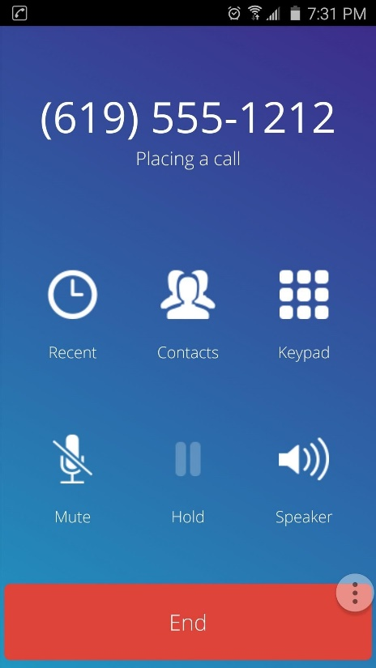
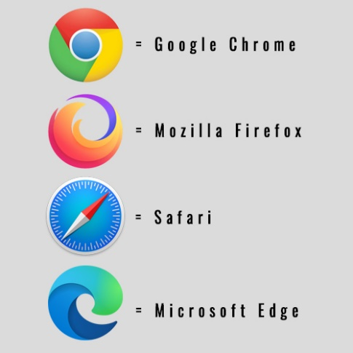
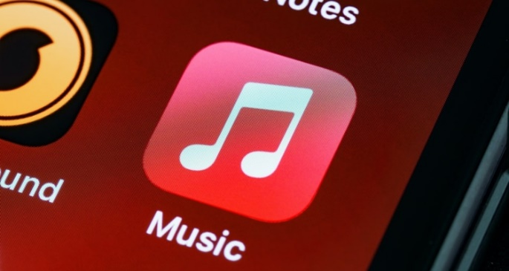

Family Software Programs and Mobile Apps
Browser: Enables you to surf the web.
Music: Allows you to listen to your mp3 music files that are stored either on your device or in the cloud.
E-mail: Allows your to communicate with other people that have your email address and that you have their email address (internet connection is typically required).
Phone: Allows you to make voice calls and send text messages to other people whose phone number you have.

Slide 45
Requirement 4
Do the following:
  Explain what a program or software application or "app" is and how it is created.
  Name four software programs or mobile apps you or your family use, and explain how each one helps you.
  Describe what malware is, and explain how to protect your digital devices and the information stored on them.

Slide 46
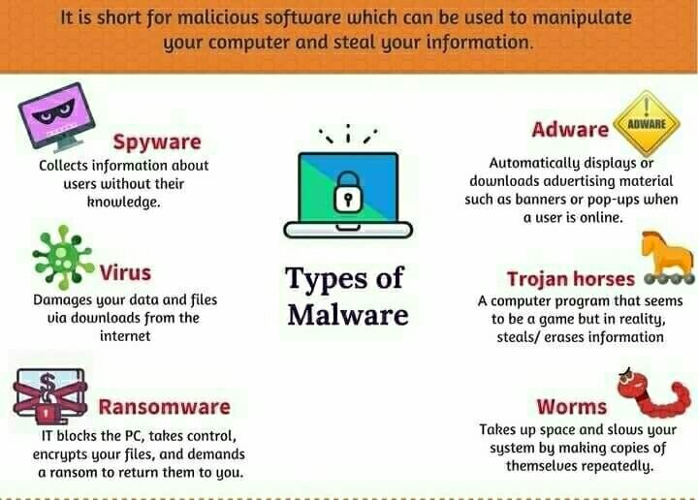
What is Malware?

Slide 47

Malware Protection
Protect your devices
Keep your operating system and applications updated.
Never click on a link in a popup. Simply close the message.
Limit the number of apps on your devices. If you no longer use an app, uninstall it.
Use security software.
Don’t lend out your phone or leave your devices unattended .
Be careful online
Avoid clicking on unknown links.
Be selective about which sites you visit and avoid risky websites (i.e. those offering free screensavers.)
Beware of emails requesting personal information.
Pay attention to downloads and other software purchases
Only purchase security software from a reputable company via their official website or in a retail store.
Stick to official app stores.
Do not open an email attachment unless you know what it is, even if it came from a friend or someone you know.
Perform regular checks
If you are concerned that your device may be infected, run a scan using the security software you have installed on your device.

Slide 48
Requirement 5
Do the following:
  Describe how digital devices are connected to the internet.
  Using an internet search engine (with your parent or guardian's permission), find ideas from at least three different websites about how to conduct a troop court of honor or campfire program. Present the ideas to your counselor, and explain how you used a search engine to find this information.
  Use a web browser to connect to an HTTPS (secure) website (with your parent's permission). Explain to your counselor how to tell whether the site's security certificate can be trusted, and what it means to use this kind of connection.

Slide 49
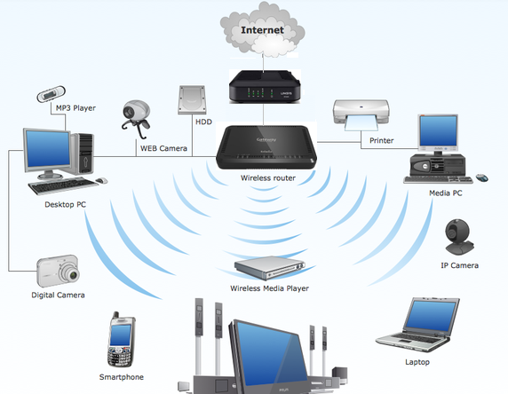
Digital devices are connected to the internet by several technologies, often at the same time.
Your families desktop PC, laptop, or tablet may be connected to your home’s wireless network router which, in turn, is connected to your Internet Service Provider (ISP) by cable, fiber, or even satellite.
Your smart phone maybe connected to the same wireless network as the other digital devices in your home or may be connected to your phone/internet service provider by a 4G or 5G cellular network.

Slide 50
Requirement 5
Do the following:
  Describe how digital devices are connected to the internet.
  Using an internet search engine (with your parent or guardian's permission), find ideas from at least three different websites about how to conduct a troop court of honor or campfire program. Present the ideas to your counselor, and explain how you used a search engine to find this information.
  Use a web browser to connect to an HTTPS (secure) website (with your parent's permission). Explain to your counselor how to tell whether the site's security certificate can be trusted, and what it means to use this kind of connection.

Slide 51




Internet Search Engines
A search engine is a software system that is designed to carry out web searches.
They search the World Wide Web in a systematic way for particular information specified in a textual web search query.
Click on one of the logos to the right to access the most popular search engines in the U.S.
Find ideas from at least three different websites about how to conduct a troop court of honor or campfire program.

Slide 52
Requirement 5
Do the following:
  Describe how digital devices are connected to the internet.
  Using an internet search engine (with your parent or guardian's permission), find ideas from at least three different websites about how to conduct a troop court of honor or campfire program. Present the ideas to your counselor, and explain how you used a search engine to find this information.
  Use a web browser to connect to an HTTPS (secure) website (with your parent's permission). Explain to your counselor how to tell whether the site's security certificate can be trusted, and what it means to use this kind of connection.

Slide 53
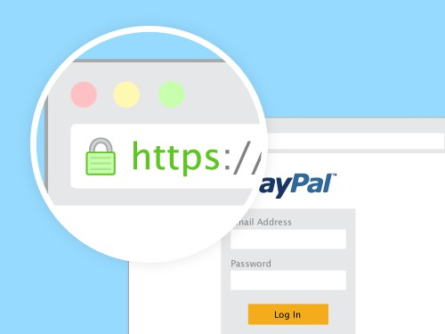
How to Know a Website is Secure
Check the URL of the website and see if it says “HTTPS” at the start of the address (instead of “HTTP”).
  This means the website is secure with an SSL certificate.
  The SSL certificate is used to secure all data that is passed from the browser to the website’s server.
If you look at the address bar of your browser and see a small padlock before the address, the website is secure.
  Clicking on it, a message stating that “the connection to this site is secure” will appear, depending on your browser, of course.

Slide 54

What does it mean to use a secure connection?
This means that there is a company guaranteeing that the communication between you and the company responsible for the website cannot be intercepted or modified.
Imagine that you go to a shopping website and inform the company about your personal data.
Without SSL certification, this information could be copied — without you or the store noticing any hack.
Therefore, the first step to check if a website is safe is to verify that it has that certification.

Slide 55
Requirement 6
Do THREE of the following. For each project you complete, copy the files to a backup device and share the finished projects with your counselor.
  Using a spreadsheet or database program, develop a food budget for a patrol weekend campout OR create a troop roster that includes the name, rank, patrol, and telephone number of each Scout. Show your counselor that you can sort the roster by each of the following categories: rank, patrol, and alphabetically by name.
  Using a word processor, write a draft letter to the parents of your troop's Scouts, inviting them to a troop event.
  Using a graphics program, design and draw a campsite plan for your troop OR create a flier for an upcoming troop event, incorporating text and some type of visual such as a photograph or an illustration.
  Using a presentation software program, develop a report about a topic approved by your counselor. For your presentation, create at least five slides, with each one incorporating text and some type of visual such as a photograph or an illustration.
  Using a digital device, take a picture of a troop activity. Send or transfer this image to a device where it can be shared with your counselor.
  Make a digital recording of your voice, transfer the file to a different device, and have your counselor play back the recording.
  Create a blog and use it as an online journal of your Scouting activities, including group discussions and meetings, campouts, and other events. Include at least five entries and two photographs or illustrations. Share your blog with your counselor. You need not post the blog to the internet; however, if you choose to go live with your blog, you must first share it with your parents AND counselor AND get their approval.
  Create a web page for your troop, patrol, school, or place of worship. Include at least three articles and two photographs or illustrations. Include at least one link to a website of interest to your audience. You need not post the page to the internet; however, if you decide to do so, you must first share the web page with your parents AND counselor AND get their approval.

Slide 56




Requirement 6
Your choice of any 3 from Requirement 6.

Slide 57
Requirement 7
Do the following:
  Explain to your counselor each of these protections and why they exist: copyright, patents, trademarks, trade secrets.
  Explain when it is permissible to accept a free copy of a program from a friend.
  Discuss with your counselor an article or a news report about a recent legal case involving an intellectual property dispute.

Slide 58



Copyrights
A Copyright is a legal right created by the law of a country, that grants the creator of an original work exclusive rights to its use and distribution, usually for a limited time, with the intention of enabling the creator to receive compensation for their intellectual effort.
Encourages original work to be created with the intent it is protected and can be profitable to the creator

Slide 59
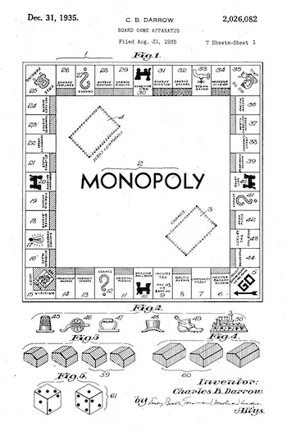
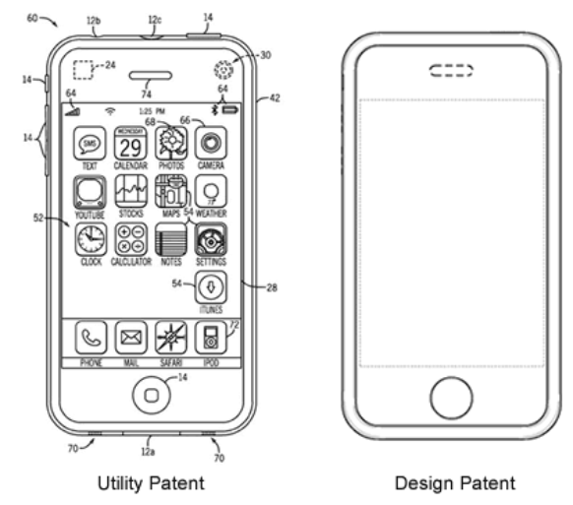
Patents
A Patent is a form of intellectual property protection that gives the creator of an invention the exclusive legal right to market, sell, manufacture, and profit from that invention for a limited period of time in exchange for detailed public disclosure of an invention.

Slide 60




Trademarks
A Trademark is a recognizable sign, design or expression which identifies products, services or a company from those of others.
Trademark owners can be individuals, business organizations or any legal entity.
Trademarks can be located on packaging, labels, print media or even verbal phrases.
Provides protection of a unique design or expression to its creator or owner.
Protects the owner from misuse or impersonation and creates an identity.

Slide 61



Trade Secrets
A Trade Secret is an invented formula, practice, process, design, instrument, pattern, commercial method or compilation of information which is not generally known or reasonably ascertained by others, and by which a business can obtain an economic advantage over competitors or customers.
Legally recognizes unique solutions as the property of the developer
Protects the solutions and methods of a developer from being forcibly divulged while keeping products unique and safe.

Slide 62

Free Copies of Programs
Software can be protected by copyright, trademark and patent laws.
The defining difference in the software world is how the software is “Licensed”.
You can freely share software with your friend if it is Open Source licensed software.
Open source means that software is made available, including its source code, for distribution or modification.
Free and Open Source Software

Slide 63




Digital Technology
Open Source vs. Proprietary
Open Source software can often be as capable, or more capable than proprietary software.
Below are some examples of proprietary software and open source alternatives.
Proprietary
Open Source

Slide 64
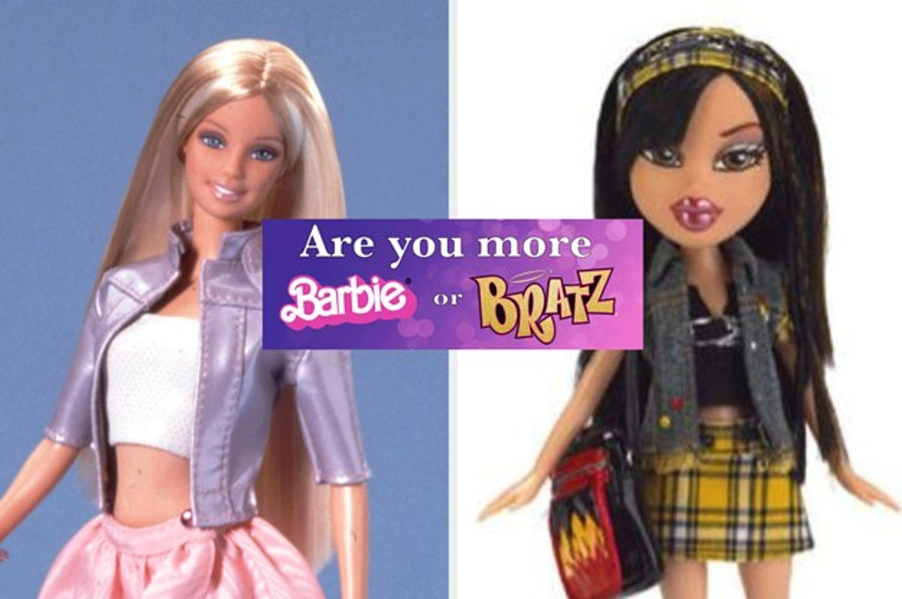
Intellectual Property Disputes
Mattel Inc. v. MGA Entertainment Inc.
  The successful Bratz Dolls were launched in 2001 as a rival to Barbie, who first came on the scene in 1959.
  Within two years, $1 billion of Bratz dolls were sold.
  Because the Bratz creator, Carter Bryant, had previously worked for Mattel, they made the case that he broke his employee agreement that any intellectual property he created would be the property of Mattel.
  In 2008, Mattel’s case against MGA went to court, and a jury ruled in Mattel’s favor, awarding it $100 million under the reasoning that Bryant had illegally sold his idea.
  It also gave Mattel rights over the Bratz line of dolls as well.
  That was reversed a year later when MGA was awarded $300 million in damages, fees, and costs after courts decided that they failed to recognize how much work was done by MGA in developing their designs.

Slide 65


Intellectual Property Disputes
A&M Records, Inc. v. Napster Inc.
  The file-sharing platform Napster launched in 1999.
  It allowed music lovers to easily download music from other users’ digital libraries.
  A year later it had 20 million users across the globe.
  The company’s launch transformed the music industry so much so that 2000 was the first year that record sales ever dipped on a global scale.
  Many sued, including BMG, EMI, Sony, Warner and Universal, and in 2001, courts ruled against Napster for breach of copyright.

Slide 66
Requirement 8
Do TWO of the following:
  Describe why it is important to properly dispose of digital technology. List at least three dangerous chemicals that could be used to create digital devices or used inside a digital device.
  Explain to your counselor why it is important to use a certified recycler of digital technology hardware or devices.
  Do an internet search for an organization that collects discarded digital technology hardware or devices for repurposing or recycling. Find out what happens to that waste. Share with your counselor what you found.
  Visit a recycling center that disposes of digital technology hardware or devices. Find out what happens to that waste. Share what you learned with your counselor.
  Find a battery recycling center near you and find out what it does to recycle batteries. Share what you have learned with your counselor about the proper methods for recycling batteries.

Slide 67
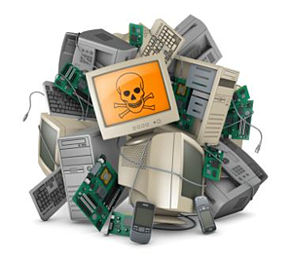
Digital Technology Disposal
Electronic devices are a complex mixture of many different materials.
  A single smartphone contains between 500 and 1,000 components.
  Many of these contain toxic heavy metals as well as hazardous chemicals and materials which do not decay.
Proper disposal of electronics protects the environment, humans and wildlife from exposure to dangerous and toxic materials that are in digital technology devices.

Slide 68
Digital Technology Disposal
Some dangerous chemicals used in electronic devices include:
  Brominated Flame Retardants – used in circuit boards and casings.
    Long term exposure can lead to impaired learning and memory functions.
    It can also interfere with thyroid and estrogen hormone systems
  Lead – Used in cathode ray tubes (CRT) in monitors.
    Exposure can cause intellectual impairment, and damage nervous, blood and reproductive systems.
  Mercury – Used in lighting for flat screen displays.
    Can damage the brain and nervous system especially during early development
  Hexavalent Chromium Compounds – Used in metal housing production.
    Highly toxic and carcinogenic to humans and animals.
  Polyvinyl Chloride (PVC) – Used in wire and cable insulation.
    Releases highly persistent and toxic fumes when burned.

Slide 69
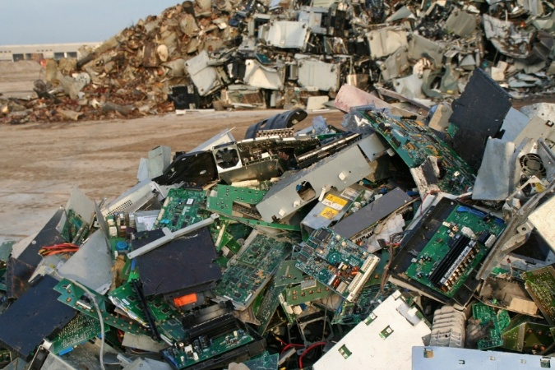
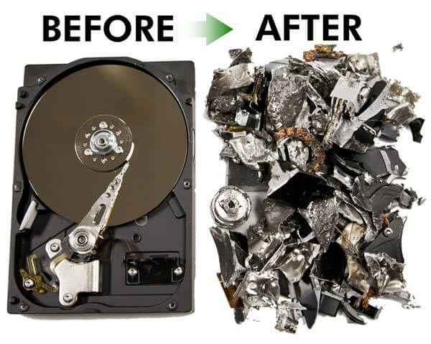
Certified Digital Technology Recycling
It's important to understand the environmental and security reasons for using a certified recycler when disposing of digital technology hardware or devices. Here’s why:
  Environmental Responsibility
    Prevents E-Waste Pollution: Electronic waste (e-waste) contains harmful materials like lead, mercury, and cadmium, which can leak into the environment if not properly disposed of.
    Recycles Valuable Materials: Certified recyclers recover and reuse precious metals (gold, silver, copper) from old devices, reducing the need for mining.
    Reduces Landfill Waste: By recycling, you help reduce the amount of toxic waste that ends up in landfills.
  Data Security
    Protects Personal Information: Your old devices may still contain personal data (photos, passwords, financial info). Certified recyclers use secure data destruction methods to wipe or destroy data.
    Prevents Identity Theft: Improper disposal can lead to hackers recovering your data from old hard drives or devices.

Slide 70
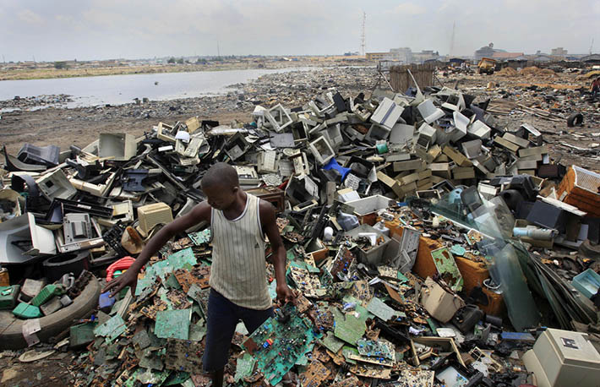
Certified Digital Technology Recycling
It's important to understand the environmental and security reasons for using a certified recycler when disposing of digital technology hardware or devices. Here’s why (continued):
  Legal and Ethical Responsibility
    Meets Environmental Laws: Many countries have strict regulations on e-waste disposal. Certified recyclers ensure compliance with these laws.
    Encourages Ethical Recycling: Some uncertified recyclers illegally export e-waste to developing countries, where it is improperly disposed of, harming people and ecosystems.
  Supports the Circular Economy
    Repurposes Old Tech: Many devices can be refurbished and reused instead of being thrown away.
    Creates Jobs: E-waste recycling supports industries and jobs in tech refurbishing and sustainable manufacturing.

Slide 71

Certified Digital Technology Recycling
How to Find a Certified Recycler?
  Look for recyclers certified by organizations like:
    R2 (Responsible Recycling)
    e-Stewards
    Local Government E-Waste Programs
  Click on the following link to find an R2 Certified Facility.

Slide 72

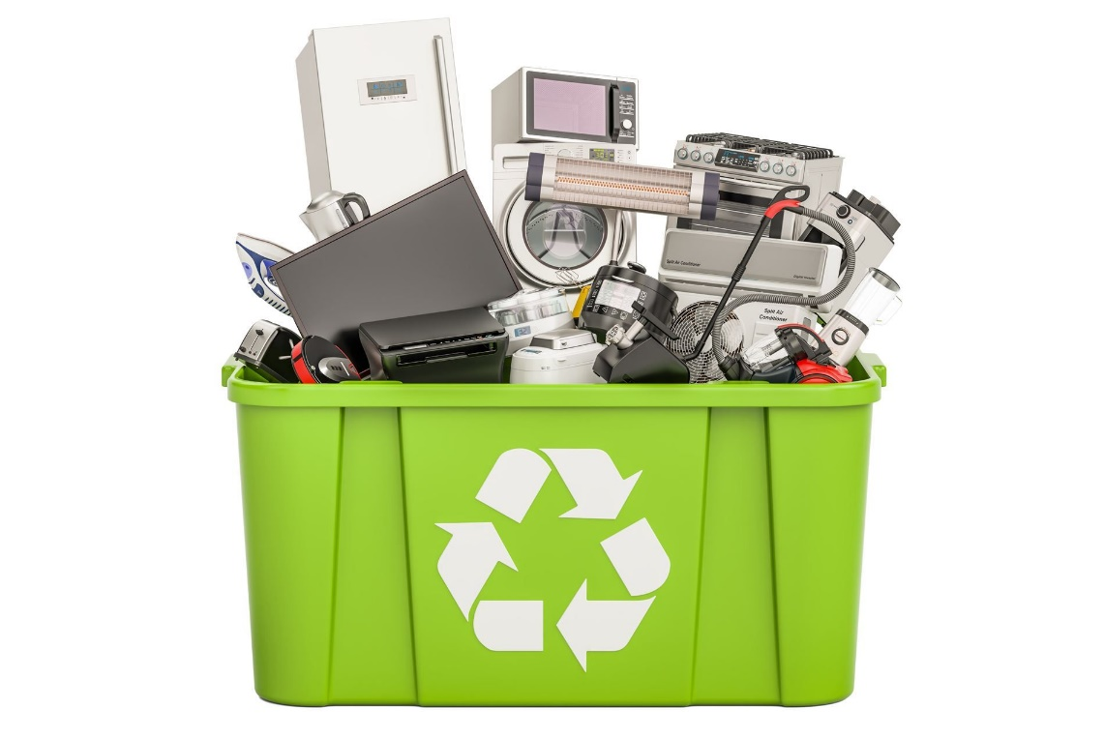



Digital Technology Recycling Organizations
Businesses that support recycling of digital technology, devices, and batteries.

Slide 73
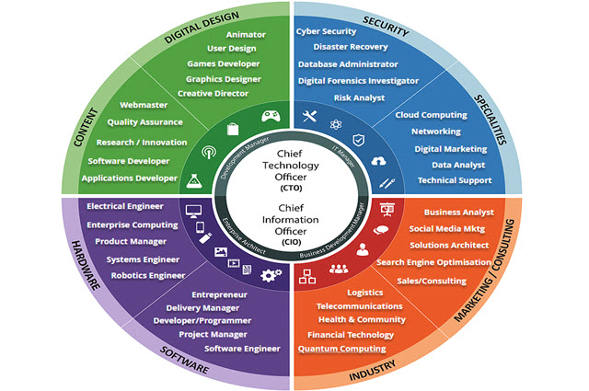
Requirement 9
Do ONE of the following:
  Identify three career opportunities that involve digital technology. Pick one and investigate the education, training, and experience required for this profession. Discuss this with your counselor, and explain why this profession might interest you.
  Visit a business or an industrial facility that uses digital technology. Describe four ways digital technology is being used there. Share what you learned with your counselor.

Slide 74

Career Opportunities in Digital Technology
Software Developer
  Education: Bachelor’s degree in Computer Science, Software Engineering, or a related field.
  Training: Coding boot camps, online courses, or internships can supplement formal education.
  Experience: Knowledge of programming languages (e.g., Python, Java, C++), problem-solving skills, and real-world projects or internships.

Slide 75

Career Opportunities in Digital Technology
Cybersecurity Analyst
  Education: Bachelor’s degree in Cybersecurity, Information Technology, or Computer Science.
  Training: Security certifications such as CompTIA Security+, Certified Ethical Hacker (CEH), or Certified Information Systems Security Professional (CISSP).
  Experience: Hands-on experience with network security, risk assessment, and penetration testing through internships or entry-level IT security roles.

Slide 76
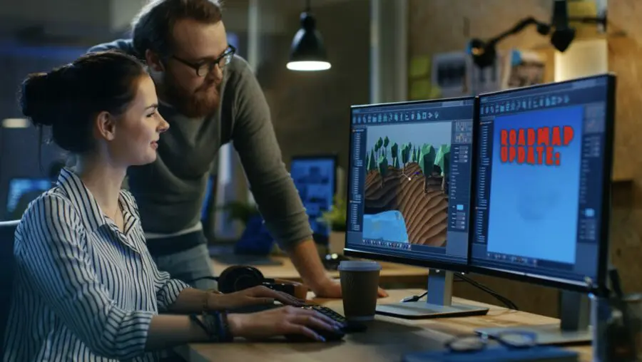
Career Opportunities in Digital Technology
Game Developer
  Education: Bachelor’s degree in Game Design, Computer Science, or Interactive Media.
  Training: Game development boot camps, online tutorials (Unity, Unreal Engine), and game jams.
  Experience: Proficiency in programming languages (C++, C#), experience with game engines, and building personal or team projects.

Slide 77
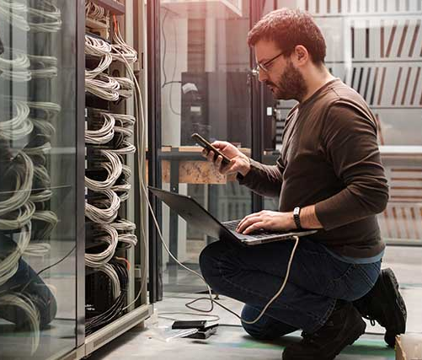
Career Opportunities in Digital Technology
IT Support Specialist
  Education: Associate degree or certification in Information Technology, Computer Science, or a related field.
  Training: Certifications like CompTIA A+, Microsoft Certified: Azure Fundamentals, or Google IT Support.
  Experience: Hands-on troubleshooting, customer service skills, and experience with hardware/software support.

Slide 78

Career Opportunities in Digital Technology
Artificial Intelligence (AI) Engineer
  Education: Bachelor’s or Master’s degree in Artificial Intelligence, Machine Learning, or Computer Science.
  Training: Courses on AI, deep learning, and neural networks (e.g., TensorFlow, PyTorch) and AI-related certifications.
  Experience: Proficiency in machine learning algorithms, data science tools, and real-world AI model development.

